Slide 1
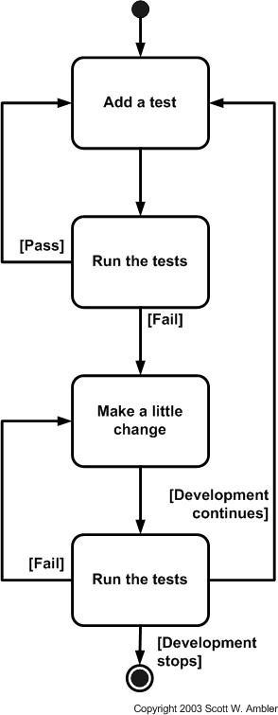
TestNG Framework for Extensive Testing & TDD
Features
TestNG is a testing framework inspired from JUnit and Nunit
Designed to cover all categories of tests: unit, functional, end-to-end, integration etc.,
Designed to perform Multi threaded testing, to help in load and stress testing.
Designed to Group Test Scripts and run them selectively.
Designed to run test scripts based on dependencies & failures.
Designed to check module performance such as response time with test timeouts.
Has a flexible plugin API for report creation and for even changing core behavior.
System Testing
Module Testing
Unit Testing
Benefits
Overcomes the drawbacks of JUNIT Framework.
One Stop Shop for various kinds of testing.
Dependency testing, grouping concept to make testing more powerful and easy.
Thins the gaps between Development and Testing and encourages Test Driven Development (TDD).
Combined use of several TestNG's features provides for a very intuitive and maintainable testing design.
Easy Migration from JUNIT to TestNG.
Easy Integration with framework & tools like Spring, Selenium, Guice, Jenkins etc.
Easy Reporting

